Slide 1

Research and Resources
for Cultural Transformation through Biblical Worldview
Featuring Dr. George Barna
& American Worldview Inventory 2020 Results

Slide 2
KEY CRC WORLDVIEW INITIATIVES
American Worldview Inventory
ACU Student Worldview Inventory
ACU Worldview Assessment
American Worldview Council
Research and Resources
for Cultural Transformation
Through Biblical Worldview

Slide 3

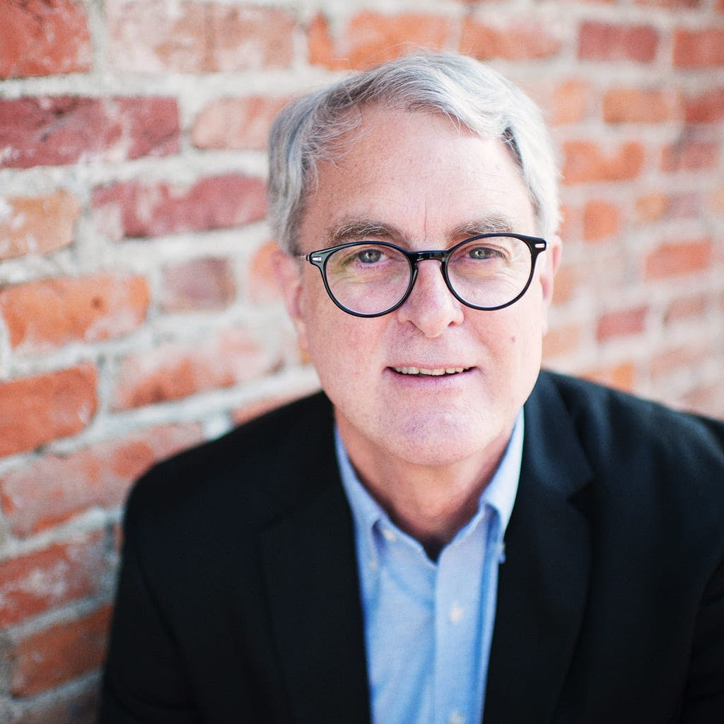
Worldview, Millennials and America’s Future
Dr. George Barna
Professor & Director of Research,
Cultural Research Center at Arizona Christian University

Slide 4
Crisis?
Political crisis
Economic crisis
Environmental crisis
Family crisis
Healthcare crisis
Educational crisis
Terrorism crisis
Digital security crisis
Border crisis

Slide 5
The Root Crisis?
America has a Worldview Crisis

Slide 6
Worldview Realities
Everyone has a worldview
Your worldview is the filter through which you experience and respond to the world –
  the filter through which you make decisions
Because your worldview enables you to make sense of the world, you need a worldview to survive

Slide 7
Decisions
Having a child
Becoming obese
Sex outside of marriage
Cheating on tax returns
Donating money to charities
Attending a church service
Doubting the existence of God
Discriminating based on race
Sending a note of encouragement
Stealing merchandise
Legalizing same-sex marriage
Instituting no-fault divorce
Opening national borders
Depleting Social Security reserves
Allowing national debt
Legalizing abortion
Mandating the COVID “vaccine”
Removing God, prayer, Bible from public schools
Withdrawing troops from nations
Maintaining the Medicare system

Slide 8
Worldview Realities
Your worldview is the accumulation of your most important beliefs
Those beliefs determine your behavior
Key principle: you do what you believe
Therefore, worldview is the combination of your core beliefs and their resulting behaviors

Slide 9
Worldview Development
In the U.S., a person’s worldview starts to develop at 15-18 months of age
Our worldview is almost fully formed by age 13
It is then refined into final form during teens and twenties
Research: Most Americans die with the same basic worldview they had at age 13 – expanded and better articulated, but essentially unchanged

Slide 10
The Four Phases Of Worldview Experience
Ages 1-12
Experimentation
Development
Ages 13-24
Refinement
Ownership
Ages 25-59
Consistency
Transmission
Ages 60+
•Reflection
•Reconsideration
• Nurture
Filtering
Testing
Application

Slide 11
Where Did Your
Worldview Come From?
Every decision you make is based on your worldview
Your worldview is shaped by many external influences
Those influences expose us to many different worldviews

Slide 12
Significant Sources Of Influence
Vary By Age Group
Children | Teens | Adults
Arts & Entertainment | Arts & Entertainment | Arts & Entertainment
News & Info Media | News & Info Media | News & Info Media
Public policy/laws | Public policy/laws | Public policy/laws
Family | Family | Family
Peers | Peers | Books
School | Celebrities/Athletes | Affinity Groups

Slide 13
How We Develop Our Worldview
Faced with numerous options, we pick and choose whichever options seem reasonable or comfortable to us
Our worldview: a patchwork of complementary, conflicting, contradictory beliefs and behaviors
We weave those choices together into a custom blend that becomes our philosophy of life
Because we cut and paste our worldview together, nobody has a pure, singular, perfectly consistent worldview – no matter which worldview dominates

Slide 14
Contributing Worldviews
Your
Worldview
Biblical Theism
Secular Humanism
Eastern Mysticism
Moralistic Therapeutic Deism
Postmodernism
Marxism
Nihilism
Existentialism

Slide 15
One Option: The Biblical Worldview
Americans’ worldviews are a personal and unique synthesis of many different worldviews
One of those options is the Biblical Theism – better known as the Biblical Worldview
A biblical worldview is a way of experiencing, interpreting, and responding to reality consistent with biblical perspectives
The biblical worldview allows you to be a disciple of Jesus Christ by enabling you to think like Jesus so you can live like Jesus

Slide 16
Worldview Dominance
In an ideal world, the biblical worldview would be dominant
We do not live in an ideal world
In America today, the biblical worldview is far from being dominant

Slide 17
Seeking Genuine Christianity

Slide 18
Biblical Worldview Incidence
Is On a Steady Decline
12 PERCENT TO 6 PERCENT

Slide 19
America’s Worldview Crisis
(% with the biblical worldview)
Source: Cultural Research Center @ Arizona Christian University
6% of all
adults 18+
19% of theologically-defined born again Christians
4% of Millennials
21% who attend an evangelical church
1% of Catholics

Slide 20
Worldview Incidence in the U.S.

Slide 21
Does Worldview Really Matter?
Worldview Measure | Have BWV | No BWV | Ratio
There is no such thing as absolute moral truth | 5% | 55% | 11:1
Success: consistent obedience to God | 98% | 18% | 5:1
Wealth: from God, manage for kingdom | 81% | 17% | 5:1
Having sex, if in love, expect to get married, still not OK | 97% | 23% | 4:1
History is God’s story, constantly moving toward fulfilling His plan | 98% | 25% | 4:1
Having faith matters more than which faith | 26% | 78% | 3:1
Marriage: 1 man to 1 woman, God’s only plan, across all cultures | 93% | 33% | 3:1

Slide 22
Does It Really Matter?
It Radically Affects Political Life
Political Measure | Have BWV | No BWV | Ratio
Social Conservative | 88% | 36% | 5:2
Social Liberal | 4% | 40% | 1:10
Fiscal Conservative | 88% | 41% | 2:1
Fiscal Liberal | 5% | 30% | 1:6
Governance Conservative | 82% | 40% | 2:1
Governance Liberal | 4% | 30% | 1:7
Support repeal Roe v. Wade | 67% | 38% | 7:4
2020 Presidential Vote: Trump | 80% | 44%
2020 Presidential Vote: Biden | 20% | 54%

Slide 23
Consider the Cultural
Implications of Worldview
People view pornography … because of their worldview
People embrace socialism … because of their worldview
People support LGBTQ lifestyles … because of their worldview
People get married … because of their worldview
People choose an abortion … because of their worldview
People help the poor … because of their worldview
People trust science … because of their worldview
People homeschool their children … because of their worldview

Slide 24
Worldview Isn’t Just a Game Changer…
It’s the Game!
How?
Because we do what we believe…
And what we believe enables us to think like Jesus…
Which enables us to live like Jesus.
That produces genuine disciples…

Slide 25

Reality Check: Millennials
Free digital download available at the CRC website culturalresearchcenter.com

Slide 26
Facts About Millennials
Most populous generation
Most racially diverse
Most highly educated
Primary parenting generation
Redefining human sexuality
Highly activist
Community-minded
Financially challenged
Values reflect blend of old + new
  Employment
  Family
  Attitudes
  Faith commitments
  Worldview
Huge marketplace influence
Technologically engaged, savvy

Slide 27
Challenges for Millennials
Purpose and meaning
Mental and emotional health
Relationships
Faith
In turn, these become challenges to us as parents, grandparents and cultural influencers

Slide 28
Purpose
75% are stuck at the starting gate of adult life, searching for purpose
22%: life is sacred
50%: life has no absolute/inherent value
Outgrowth: historically high suicide rate – contributors:
  Nihilism, Postmodernism, Marxism: life is meaningless, directionless, seemingly random
  Mental and emotional instabilities
  Rejection of God, truth, the Christian faith

Slide 29
Purpose: Failed Solutions
Seeking meaning through activism
Very high levels of political or civic engagement
Above-average levels of volunteering and donating within community
Below-average, yet majority involvement, in religious faith
Engaged with the world but purpose remains elusive
Seeking purpose through personal satisfaction
Nothing providing high levels of satisfaction
Pursuit of happiness as a means to purpose has failed

Slide 30
Purpose: Failed Solutions
Only moderately satisfied with most aspects of their life
  29% are very satisfied with their life overall
  no area of life for which a majority of Millennials are “very satisfied”
  “very satisfied”
    intimate relationships (38%)
    friendships (35%)
    spiritual life (31%)
    personal health (30%)
    career (27%)
    community (23%)
    personal finances (22%)
    state of nation (15%)
Emptiness
Disappointment
Frustration
Unfulfilling

Slide 31
Purpose & Worldview
The foundational premise of their pursuit is wrong
  “Life is about me”
Bad premise, bad outcomes
  life is not about us; knowing, loving, and serving God
  God, alone, determines our purpose in life
    often revealed through calling and gifts
  meaning comes from pursuing, relating to, and doing His will/His agenda

Slide 32

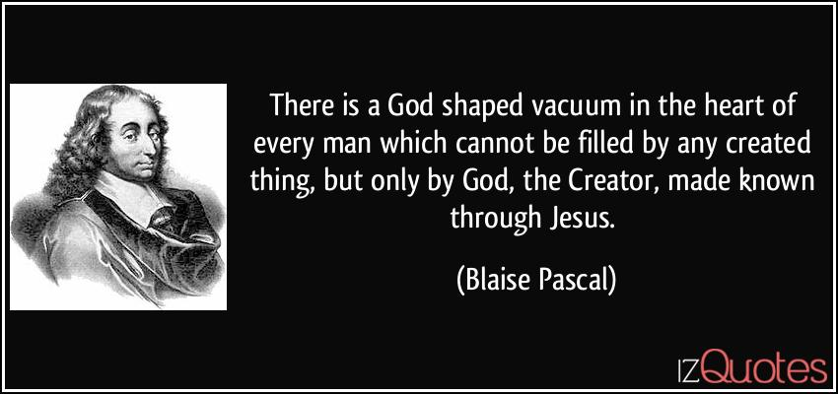
Purpose Comes from God
Purpose: Know , love and serve God with all our heart, mind, strength and soul

Slide 33
Mental Health
A majority (54%) admit to often feeling anxious, depressed, or fearful.
  the real number likely even higher
  go-to solution = medication
  other struggles: self-confidence, fear of conflict
NIMH: 21% of adults have some form of mental illness
  18-25: 29% have some type of mental disorder
  9% have a severe mental illness
  49.5% of 13-18 have one or more types of mental illness
30% identify as LGBTQ (39% among 18-24s)
  Path to acceptance and belonging > living the lifestyle
  Reflection of identity confusion

Slide 34
Mental Health & Worldview
Their mental health challenges relate to an ill-conceived perspective about self
  Self-centered
  Unrestricted moral agents
  Draw their identity from the attributes they choose to embrace and emphasize
    gender, age, race, intelligence, education, income, etc.
    seen as factors that will define/elevate their place in the world
  Consequence: our value constantly changes as the world shifts the attributes it values and its assessment of us
  Result: identity and human value become moving targets

Slide 35
Mental Health & Worldview
  Mental health challenges mitigated by biblical truth
    We become a new creation in Christ, never lose value
    God determined our identity: sexual and otherwise
    we have no authority or competence to make that choice
  Anxiety, depression, fear are put in context
    Jesus provides peace that passes all understanding
    He has determined our value
    We must fear only God
    This wisdom is unknown to the world but revealed in His words
    Anxiety, depression, and fear come from alternative worldviews
  BWV gives us the hope, power, authority, wisdom, a reason, and a way to live abundantly

Slide 36
Relationships
Difficulty developing meaningful, lasting relationships
  fluid friendships - a revolving door of intimates and acquaintances
  low level of trust toward all people and roles
  unwilling to make lasting commitments
  situational intolerance and disrespect
  rampant conflict avoidance
  low view of the value of human life
  Redefining family: low rates of marriage, high rates of cohabitation and divorce, disconnection from children
  reliance on technology prohibits deeper and more permanent ties

Slide 37
Relational Challenges
Of 9 types of cultural influencers tested, none were trusted by a majority to “always or almost always tell the truth or do what is right.”
Millennials emerged as the generation most likely to seek revenge against anyone who they feel has done them wrong
Millennials are the least open to relationships with people who hold significantly different political, social or religious opinions

Slide 38
Relationships & Worldview
Prevailing U.S. Syncretism
Biblical Worldview
Narcissistic relationships: must always satisfy personal needs
Intolerance, disrespect of opposing ideas
Indifference to the Golden Rule
Love is a feeling
Human beings lack intrinsic value, thus no investment justified
Shared experiences, meet others’ needs
Respect without compromise; all made in His image, given free will
Christ-like treatment of others
Love is a commitment, seeks best outcomes for others, involves sacrifice
God created humans, life is His gift, Jesus died to protect it

Slide 39
Faith Transitions
35% believe in God as the all-powerful, all-knowing, perfect and just creator of the universe who still rules the universe today
40% are “Don’ts”: don’t know/don’t care/don’t believe that God exists
27% do not associate with any religious faith
Just 16% are born-again Christians (US norm: 28%)
74% believe that all religious faiths are of equal value
Positive opinion of Jesus, Bible; not so re Christians, churches, pastors
2/3 reject objective or absolute moral truth; feelings, experiences, and advice from family and friends are their most trusted sources of moral guidance
31% say the Bible is the true, reliable word of God

Slide 40
The Challenges Are Even More
Profound Among 18-to-24-year Olds
Worldview & Truth:
Just 2% have a Biblical Worldview
64% say moral truth is subjective and situational, not absolute
63% say their most trusted source of moral guidance is their feelings, experiences, or input from family and friends
29% say the Bible is the true, accurate word of God
32% believe God or the Bible are the basis of truth
18%: the Bible is their primary source of guidance for moral choices

Slide 41
The Challenges Are Even More
Profound Among 18-to-24-year Olds
Sin & Salvation:
42%: humans are made in God’s image, fallen, in need of redemption
A large plurality (42%) contend that people are not born good or bad but become such based on their life choices
A majority believes you earn your salvation
Only 15% are theologically-defined born-again Christians

Slide 42
The Challenges Are Even More
Profound Among 18-to-24-year Olds
Supernatural Beings:
Almost half of 18-24s (46%) are Don’ts: don’t know if God exists, don’t care if He exists, or don’t believe that He exists
29%: God is the all-powerful, all-knowing, perfect and just creator of the universe who still rules that universe today
A plurality believes:
★ Satan is not real
    ★ Holy Spirit is not real
    ★ Having faith matters more than which faith
    ★ Jesus sinned on earth

Slide 43
The Challenges Are Even More
Profound Among 18-to-24-year Olds
Life Choices:
Only 14% define “success” in life as consistent obedience to God
A mere 1 in 6 (17%) say the universal purpose of life is to know, love and serve God with all of our heart, mind, strength and soul
21% say marriage is God’s plan for humanity, across all cultures

Slide 44
Faith Transitions
Spiritual foundations/perspectives
  reject organized religion
  qualms about religious leaders
  Most Christians seen as religious hypocrites
  there is no objective or absolute moral truth
  salvation is earned by good deeds and intentions
  there is no omniscient, omnipotent supernatural being (e.g. God)
  Bible is just another book of religious teachings written by men
  have had mostly unfulfilling spiritual experiences

Slide 45
Faith & Worldview
Misperceptions about life spring from inadequate spiritual foundation
  eliminating God, the Bible, truth, sin, salvation through Christ provides no hope or purpose; resulting in a lack of knowledge and understanding
Inadequate spiritual foundation produces a terrifying life
  Seeking immediate comfort rather than lasting truth and peace
  Experiencing moral chaos due to lack of coherent/pragmatic religious instruction, moral reflection
  Suffering identity confusion – spiritual, sexual, sense of purpose
  Poor self-image built on self-centeredness, self-reliance, independence
24 out of 25 Millennials lack a BWV – a monumental challenge for US
Syncretism is detrimental to their – and our – well-being

Slide 46
Treat the Cause, Not the Symptoms
We cannot afford to be distracted by the symptoms:
  the absence of a sense of purpose, meaning and vision
  emotional and mental health challenges
  spiritual turbulence
  relational hardships and dissatisfaction
  expansive identity crisis
It all comes down to worldview – the cause of the symptoms
  A bad worldview produces bad decisions
  Millennial lives will not improve without altering their worldview

Slide 47
Crisis?
Political crisis
Economic crisis
Environmental crisis
Family crisis
Healthcare crisis
Educational crisis
Terrorism crisis
Digital security crisis
Border crisis
Worldview Crisis

Slide 48
Q & A
Any Questions?
Research and Resources
for Cultural Transformation
Through Biblical Worldview
Featuring Dr. George Barna
& American Worldview Inventory 2020 Results

